Slide 1
Concepts of Boolean Algebra

Slide 2
Lecture 24 Tutorial
Lecture delivered by:
Deepak V.

Slide 3
Topics
Boolean algebra
Karnaugh Map

Slide 4
Objectives
At the end of this lecture, student will be able to:
Solve the problems on Boolean algebra
Solve the problems on Karnaugh map

Slide 5
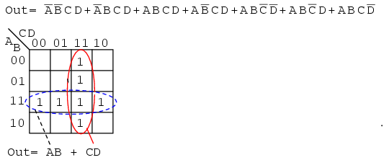
Example

Slide 6
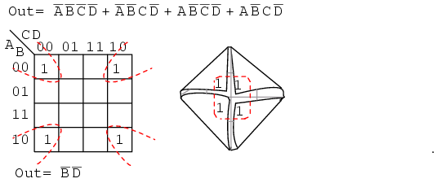
Example

Slide 7
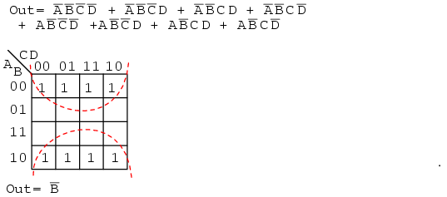
Example

Slide 8
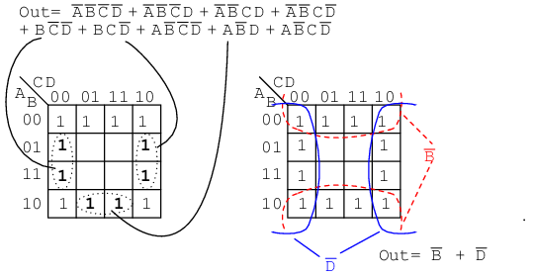
Example

Slide 9
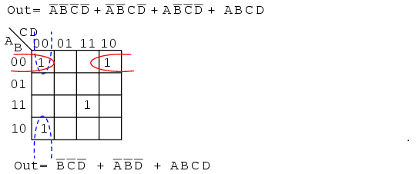
Example

Slide 10
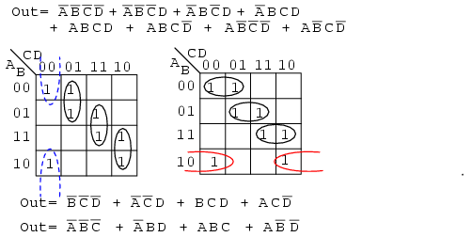
Example

Slide 11
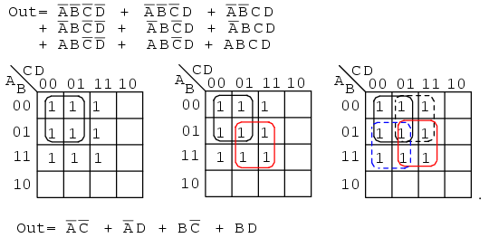
Example

Slide 12
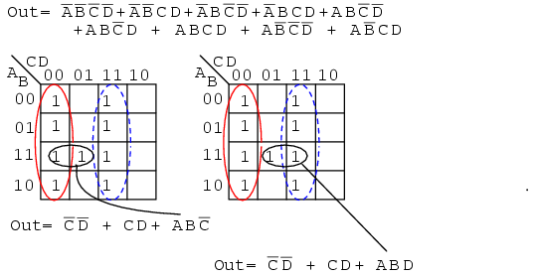
Example

Slide 13
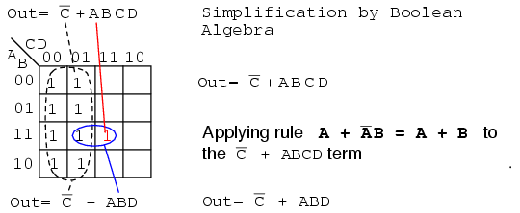
Example

Slide 14
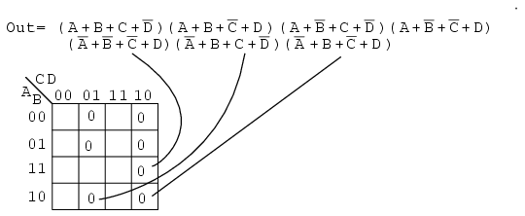
Example
Simplify the Product-Of-Sums Boolean expression below, providing a result in POS form
We map the 0s as they appear left to right top to bottom on the map above We locate the last three maxterms with leader lines

Slide 15
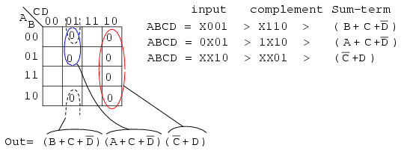
Contd..
Once the cells are in place above, form groups of cells as shown below
Larger groups will give a sum-term with fewer inputs
Fewer groups will yield fewer sum-terms in the result

Slide 16
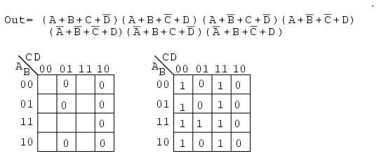
Example
Simplify the Product-Of-Sums Boolean expression below, providing a result in SOP form
Then fill in the implied 1s in the remaining cells of the map above right

Slide 17
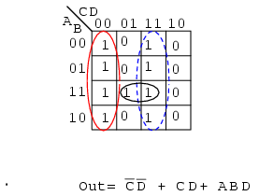
Contd..
Form groups of 1s to cover all 1s. Then write the Sum-Of-Products simplified result

Slide 18
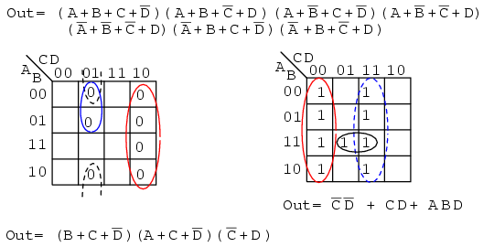
Contd..

Slide 19
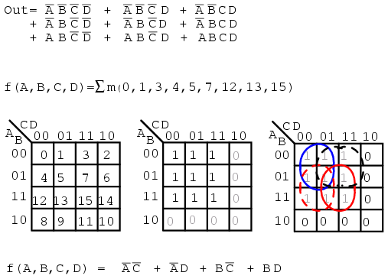
Example
f(A,B,C,D) = Σ m(1, 2, 3, 4, 5, 7, 8, 9, 11, 12, 13, 15)
or
f(A,B,C,D) = Σ(m₁,m₂,m₃,m₄,m₅,m₇,m₈,m₉,m₁₁,m₁₂,m₁₃,m₁₅)

Slide 20
Summary
All standard Boolean expression can be easily converted into truth table format using binary values for each term in the expression
Also, standard SOP or POS expression can be determined from the truth table
K-maps are an alternative to algebra for simplifying expressions

